Slide 1
FLOW CONTROL STATEMENTS
Instructor: DieuNT1

Slide 2
Table of contents
Arrays
Single Dimensional Array
Two Dimensional Array
Flow Control Statements
if..else
switch-case
While
do..while
for
break,continue, return

Slide 3
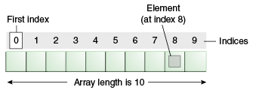
Java Arrays
Java array is an object which contains elements of a similar data type.
The elements of an array are stored in a contiguous memory location.
For example, you can create an array that can hold 100 values of int type.
It is a data structure where we store similar elements:
We can store only a fixed set of elements in a Java array.
Array in Java is index-based, the first element of the array is stored at the 0th index, 2nd element is stored on 1st index and so on.
We can store primitive values or objects in an array in Java
Like C/C++, we can also create single dimentional or multidimentional arrays in Java.
Arrays:
Data structures
Related data items of same type
Remain same size once created
Fixed-length entries

Slide 4
Types of Array in Java
There are two types of array:
Single Dimensional Array
Multidimensional Array
Single Dimensional Array Structure:
Name of array (note that all elements of this array have the same name, c)
c[ 0 ]
-45
c[ 1 ]
6
c[ 2 ]
0
c[ 3 ]
72
c[ 4 ]
1543
Value of each element
c[ 5 ]
-89
c[ 6 ]
0
c[ 7 ]
62
c[ 8 ]
-3
c[ 9 ]
1
Index (or subscript) of the element in array c, begin from 0
c[ 10 ]
6453
c[ 11 ]
78

Slide 5
Single Dimensional Array in Java
Syntax: Three ways to declare an array are
datatype[] identifier;
datatype[] identifier = new datatype[size];
datatype[] identifier = {value1,value2,…valueN};
You can also place the square brackets after the array's name:
datatype identifier[];//this form is discouraged
Example:
byte[] bArray;
float[] fArray = new float[20];
int[] iArray = { 32, 27, 64, 18, 95, 14, 90, 70, 60, 37 };
Notes:
However, convention discourages square brackets after the array's name form; the brackets identify the array type and should appear with the type designation.

Slide 6
Array Declarations
Examine array bArray, fArray, iArray:
bArray, fArray, iArray is the array name
fArray.length accesses array c’s length
iArray has 10 elements:
iArray[0], iArray [1], … , iArray [9]
The value of iArray [0] is 32

Slide 7
Array Index
Also called subscript
Position number in square brackets
Always begin from zero
Must >= 0 and < array’s length
Example:
fArray[0] = 12.5f;
for (int counter = 0; counter < iArray.length; counter++){
output += counter + "\t" + iArray[counter] + "\n";
}

Slide 8
Passing Array to a Method in Java
We can pass the Java array to method so that we can reuse the same logic on any array.
public class TestArray {
public static void main(String[] args) {
int[] intArray = { 5, 22, 16, 8, 89, 6 };
System.out.println("Max of value:" + findMax(intArray));
}
static int findMax(int[] intArray) {
int max = intArray[0];
for (int i = 1; i < intArray.length; i++) {
intArray[i] *= 2;
if (intArray[i] > max) {
max = intArray[i];
}
}
return max;
}
}

Slide 9
ArrayIndexOutOfBoundsException
The Java Virtual Machine (JVM) throws an ArrayIndexOutOfBoundsException if length of the array in negative, equal to the array size or greater than the array size while traversing the array.
Output:
public class TestArrayException {
public static void main(String[] args) {
int arr[] = { 50, 60, 70, 80 };
for (int i = 0; i <= arr.length; i++) {
System.out.println(arr[i]);
}
}
}
50
60
70
80
Exception in thread "main" java.lang.ArrayIndexOutOfBoundsException: 4
at fa.training.jpe.TestArrayException.main(TestArrayException.java:15)

Slide 10
Multidimensional Arrays
In such case, data is stored in row and column based index (also known as matrix form).
Syntax:
Example:
Initialize Multidimensional Array in Java
dataType[][] arrayRefVar; (or)
dataType [][]arrayRefVar; (or)
dataType arrayRefVar[][]; (or)
dataType []arrayRefVar[];
int[][] arr=new int[3][3];//3 row and 3 column
arr[0][0]=1;
arr[0][1]=2;
arr[0][2]=3;
arr[1][0]=4;
arr[1][1]=5;
arr[1][2]=6;
arr[2][0]=7;
arr[2][1]=8;
arr[2][2]=9;

Slide 11
Multidimensional Arrays
Two-dimensional array structure
Column 0
Column 1
Column 2
Column 3
Row 0
a[ 0 ][ 0 ]
a[ 0 ][ 1 ]
a[ 0 ][ 2 ]
a[ 0 ][ 3 ]
Row 1
a[ 1 ][ 0 ]
a[ 1 ][ 1 ]
a[ 1 ][ 2 ]
a[ 1 ][ 3 ]
Row 2
a[ 2 ][ 0 ]
a[ 2 ][ 1 ]
a[ 2 ][ 2 ]
a[ 2 ][ 3 ]
Column index
Row index
Array name

Slide 12
Multidimensional Arrays
Example: Let's see the simple example to declare, instantiate, initialize and print the 2Dimensional array.
Output:
public class Test2Dimensional {
public static void main(String[] args) {
// Declaring and initializing 2D array
int arr[][] = { { 1, 2, 3 }, { 2, 4, 5 }, { 4, 4, 5 } };
// Printing 2D array
for (int i = 0; i < 3; i++) {
for (int j = 0; j < 3; j++) {
System.out.print(arr[i][j] + "\t");
}
System.out.println();
}
}
}
1 2 3
2 4 5
4 4 5

Slide 13
Jagged Array in Java
Jagged Array is an array of arrays with different number of columns.
Example:
Output:
8 72 40
67 89 50 6 19
47 68
public class TestJaggedArray {
public static void main(String[] args) {
// Declaring a jagged array
int[][] jagArray = new int[3][];
jagArray[0] = new int[3];
jagArray[1] = new int[5];
jagArray[2] = new int[2];
Random random = new Random(2);
// Initializing a jagged array
for (int i = 0; i < jagArray.length; i++) {
for (int j = 0; j < jagArray[i].length; j++) {
jagArray[i][j] = random.nextInt(100);
}
}
// Printing the data of a jagged array
for (int i = 0; i < jagArray.length; i++) {
for (int j = 0; j < jagArray[i].length; j++) {
System.out.print(jagArray[i][j] + "\t");
}
System.out.println();
}
}
}
Notes:
Học viên có thể tham khảo Three Dimensional tại đây: https://code4coding.com/three-dimension-array-in-java-language/#:~:text=It%20is%20one%20of%20the,within%20the%20single%20variable%20name.&text=Three%2Ddimensional%20array%20is%20the,also%20called%20the%20multidimensional%20array.

Slide 14
Copying a Java Array
We can copy an array to another by the arraycopy() method of System class.
Syntax:
Example:
Output:
public static void arraycopy(Object src, int srcPos,Object dest,
int destPos, int length)
public class TestArrayCopyDemo {
public static void main(String[] args) {
// Declaring a source array
char[] copyFrom = { 'F', 'P', 'T', 'S', 'o', 'f', 't', 'w', 'a', 'r', 'e',
'A', 'c', 'a', 'd', 'e', 'm', 'y' };
// Declaring a destination array
char[] copyTo = new char[10];
// Copying array using System.arraycopy() method
System.arraycopy(copyFrom, 3, copyTo, 0, 8);
// Printing the destination array
System.out.println(String.valueOf(copyTo));
}
}
Software

Slide 15
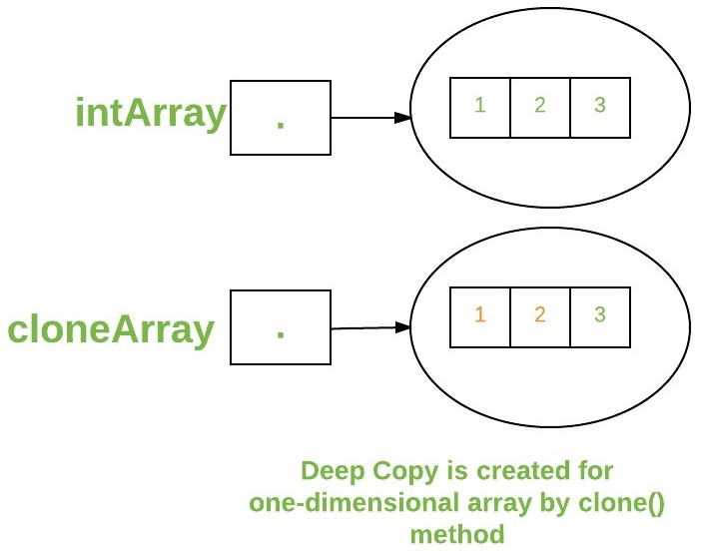
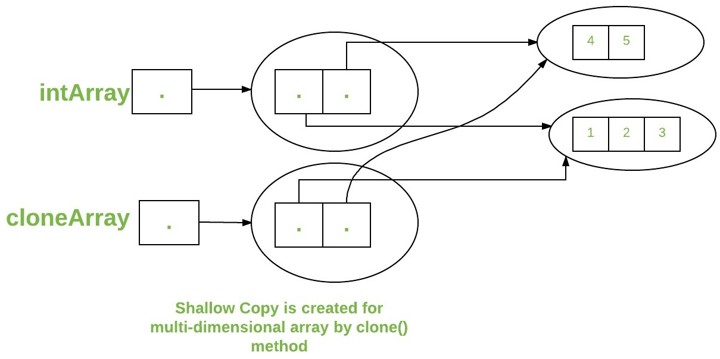
Cloning an Array in Java
We can clone an array by the clone() method.
Example:
public class TestCloneArray {
public static void main(String[] args) {
int arr[] = { 12, 5, 18, 8, 6 };
System.out.println("Printing original array:");
for (int value : arr)
System.out.println(value);
System.out.println("Printing clone of the array:");
int carr[] = arr.clone();
for (int value : carr)
System.out.println(value);
System.out.println("Are both equal?");
System.out.println(arr == carr);
}
}
Notes:
Java array implements the Cloneable interface, we can create the clone of the Java array. If we create the clone of a single-dimensional array, it creates the deep copy of the Java array. It means, it will copy the actual value. But, if we create the clone of a multidimensional array, it creates the shallow copy of the Java array which means it copies the references.

Slide 16
Flow Control Statements
Section 2

Slide 17
Flow Control Statements
Decision-making
if-else statement
switch-case statement
Loops
while loop
do-while loop
for loop
Branching
break
continue
return

Slide 18
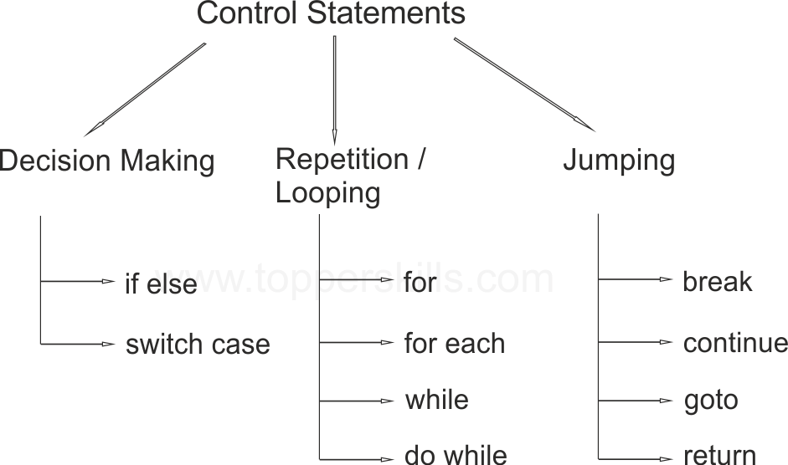
Flow Control Statements
All application development environments provide a decision making process called flow control statements that direct the application execution.
Flow control enables a developer to create an application that can examine^{[kiểm tra]} the existing conditions, and decide a suitable course of action.
Loops or iteration are an important programming construct that can be used to repeatedly execute a set of actions.
Jump statements allow the program to execute in a non-linear fashion.

Slide 19
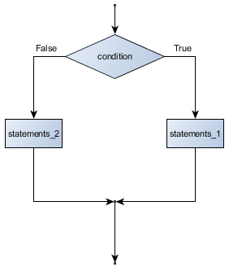
if-else statement
Syntax:
if (condition){
action1;
} else {
action2;
}
Note:
“else” is optional
Alternative way to if-else is
conditional operator ( ?: )

Slide 20
if-else statement
Example:
public class CheckNum {
public static void main(String[] args) {
// TODO Auto-generated method stub
int num = 10;
if (num % 2 == 0) {
System.out.println(num + " is an even number");
} else {
System.out.println(num + " is an odd number");
}
}
}

Slide 21
switch – case statement
Unlike if-then and if-then-else statements, the switch statement can have a number of possible execution paths.
A switch works with the byte, short, char, and int primitive data types.
It also works with enumerated types, the String class, and a few special classes that wrap certain primitive types: Character, Byte, Short, and Integer (discussed in Numbers and Strings).

Slide 22
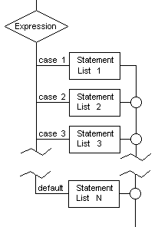
switch – case statement
Syntax:
switch(expression) {
case value_1:
statement_1; [ break;]
case value_2:
statement_2; [ break;]
…
case value_n:
statement_n; [ break;]
default:
statement_n+1; [break;]
}

Slide 23
switch – case statement
public class SwitchDemo2 {
public static void main(String[] args) {
int month = 2;
int year = 2000;
int numDays = 0;
switch (month) {
case 1:
case 3:
case 5:
case 7:
case 8:
case 10:
case 12:
numDays = 31;
break;
case 4:
case 6:
case 9:
case 11:
numDays = 30;
break;
case 2:
if ( ((year % 4 == 0) && !(year % 100 == 0))
|| (year % 400 == 0) )
numDays = 29;
else
numDays = 28;
break;
}
System.out.println("Number of Days = " + numDays);
}
}

Slide 24
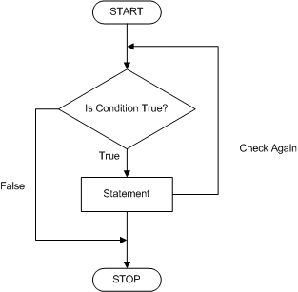
while Loop
while loops are used for situations when a loop has to be executed as long as certain condition is True.
The number of times a loop is to be executed is not pre-determined, but depends on the condition.
The syntax is:
while (condition) {
action statements;
}

Slide 25
while Loop
Example:
public class FactDemo {
public static void main(String[] args) {
// TODO Auto-generated method stub
int num = 5, fact = 1;
while (num >= 1) {
fact *= num;// fact = fact * num;
num--;
}
System.out.println("The factorial of 5 is : " + fact);
}
}

Slide 26
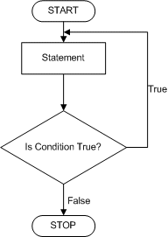
do – while Loop
The do-while loop executes certain statements till the specified condition is True.
These loops are similar to the while loops, except that a do-while loop executes at least once, even if the specified condition is False.
The syntax is:
do {
action statements;
} while (condition);

Slide 27
do – while Loop
Example:
public class DoWhileDemo {
public static void main(String[] args) {
int count = 1, sum = 0;
do {
sum += count;
count++;
} while (count <= 100);
System.out.println("The sum of first 100 numbers is : " + sum);
}
}

Slide 28
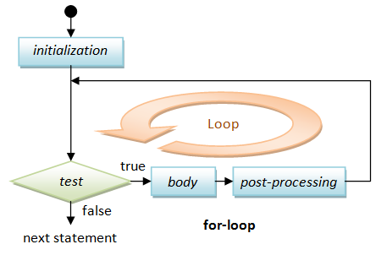
for Loop
All loops have some common features: a counter variable that is initialized before the loop begins, a condition that tests the counter variable and a statement that modifies the value of the counter variable.
The for loop provides a compact format for incorporating these features.
Syntax:
for (initialization;loopContinuationCondition; increment)
{ statement;
}

Slide 29
for Loop
Example:
public class ForDemo {
public static void main(String[] args) {
// TODO Auto-generated method stub
int count = 1, sum = 0;
for (count = 1; count <= 10; count += 2) {
sum += count;
}
System.out.println("The sum of first 5 odd numbers is : " + sum);
}
}

Slide 30
Break Statements
The break statement has two forms: labeled and unlabeled.
Use unlabeled break to terminate a switch, for, while, or do-while loop
Use labeled break to terminates an outer statement
Example:
public class BreakDemo {
public static void main(String[] args) {
// TODO Auto-generated method stub
for (int count = 1; count <= 100; count++) {
if (count == 10) {
break;
}
System.out.println("The value of num is : " + count);
}
System.out.println("The loop is over");
}
}

Slide 31
Continue statement
The continue statement skips the current iteration of a for, while , or do-while loop.
The unlabeled form skips to the end of the innermost loop's body and evaluates the boolean expression that controls the loop.
The labeled continue statement skips the current iteration of an outer loop marked with the given label.

Slide 32
Continue statement
Example:
public class ContinueDemo {
public static void main(String[] args) {
String searchMe = "peter piper picked a peck of pickled peppers";
int max = searchMe.length();
int numPs = 0;
for (int i = 0; i < max; i++) {
// interested only in p's
if (searchMe.charAt(i) != 'p') {
continue;
}
numPs++;
}
System.out.println("Found " + numPs + " p's in the string.");
}
}

Slide 33
Return statement
The return statement exits from the current method, and control flow returns to where the method was invoked.
The return statement has two forms:
Returns a value: return ++count;
Doesn't returns a value (void): return;
The data type of the returned value must match the type of the method's declared return value.

Slide 34
Practice time
Exercise 1: Program to find the frequency of each element in the array.
Excersie 2: Program to left rotate the elements of an array.
(Nếu có đủ thời gian thì cho thực hành/demo tại lớp, nếu không thì học viên có thể được hướng dẫn để làm thêm ở nhà).

Slide 35
SUMMARY
Arrays
Single Dimensional Array
Two Dimensional Array
Flow Control Statements
if..else
switch-case
while
do..while
for
break,continue, return

Slide 36

Thank you
36

